Slide 1

Vrinda Store Analysis
Anjali Khatri

Slide 2
Sample Questions For Analysis
Compare the sales and order for the year of 2022
Which month got the highest sales and Orders
Compare the men vs women purchasing proportion
List top 5 states which contributed to the sales
Explain the relationship between age and gender
Which channel contributed to the maximum sales

Slide 3
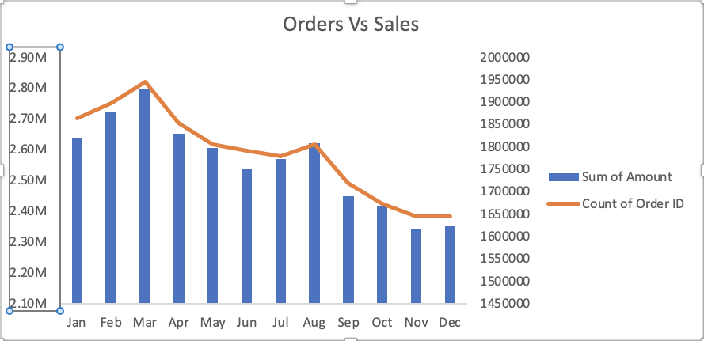
Comparison of Sales & Orders for 2022
The month of March had the highest number of orders contributing to the highest sales amount

Slide 4
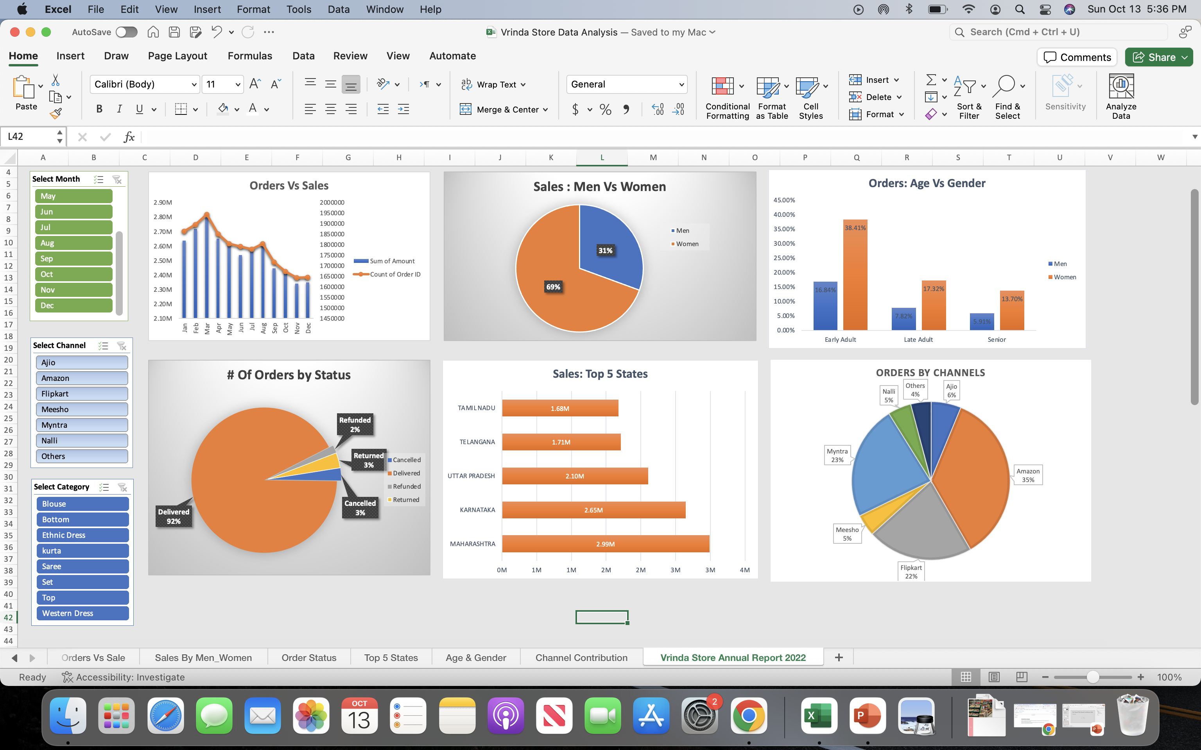
Shopping Proportion by Age & Gender

Slide 5
Top 5 States & Top Channels Contributing to Sales

Slide 6
Insights From Analysis
Month of March drove the highest amount of sales. Ongoing promotions or the onset of a new season could have led the consumer to spend more on the store’s products.
Women had a higher proportion of purchasing in comparison to men. To drill down further, women in the age category of ‘Early Adult’ representing age range 18 – 39 had the highest share of sales. The store should consider targeting their promotions to women falling in this bucket. On the other hand, senior category contributed the lowest to store’s sales. The store could be missing out on potential market share and should brainstorm ways to increase their share of sales for the senior customers
Maharashtra followed by Karnataka ranked as the highest states in terms of sales. Amazon, Myntra and Flipkart being the three largest online retail platforms in India, indicates that the store should continue to push their products on these platforms. One suggestion for the store would be to potentially weigh the benefits of pulling out of the other platforms and redirecting the effort as well as the budget towards bigger platforms only.

